Slide 1
Parametrized PDE Prediction
Yaduo LI
Dec, 2019

Slide 2
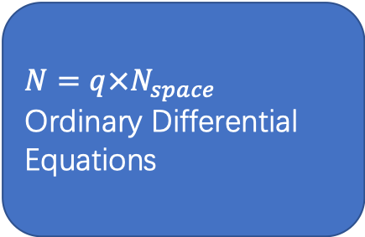
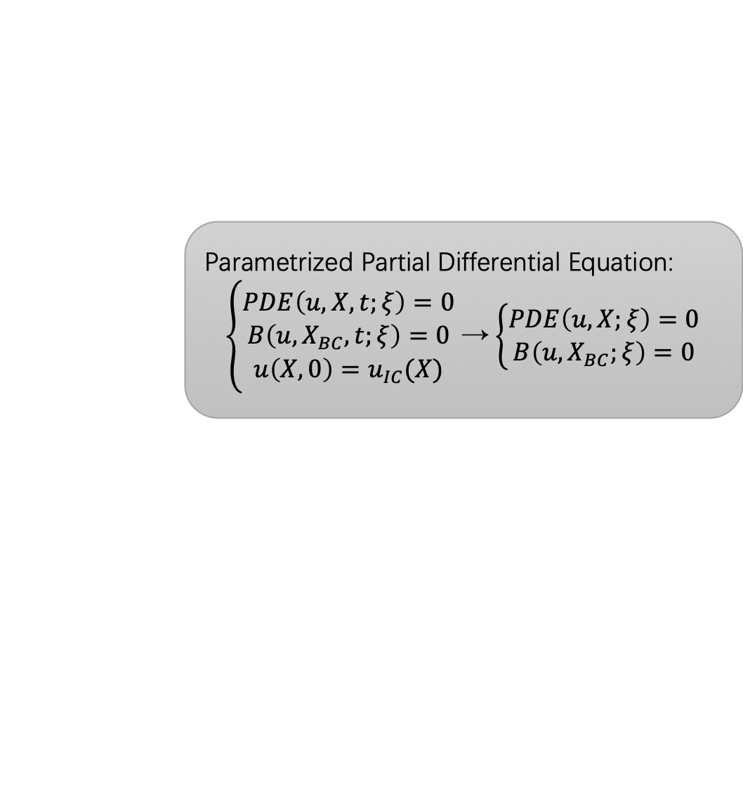
Introduction
Parametrized Partial Differential Equation:
$\left\{\begin{aligned}PDE\left(u,X,t;ξ\right)=0 \\ B\left({u,X}_{BC},t;ξ\right)=0 \\ u\left(X,0\right)=u_{IC}(X)\end{aligned}\right.$ → $\left\{\begin{aligned}PDE\left(u,X;ξ\right)=0 \\ B\left({u,X}_{BC};ξ\right)=0\end{aligned}\right.$
High computation cost of each simulation
New simulation when changing set of parameters 𝜉
Discretized in space
$N=q×N_{space}$ Ordinary Differential Equations
High Dimensional Model

Slide 3
Aim
Aim
Predicting the results of a PDE problem in a specified parameter domain based on a group of observations.
Objective
Fix points PDE resolution
Adaption of the solutions to a full parameters domain
Performance comparison of different methodlogies

Slide 4
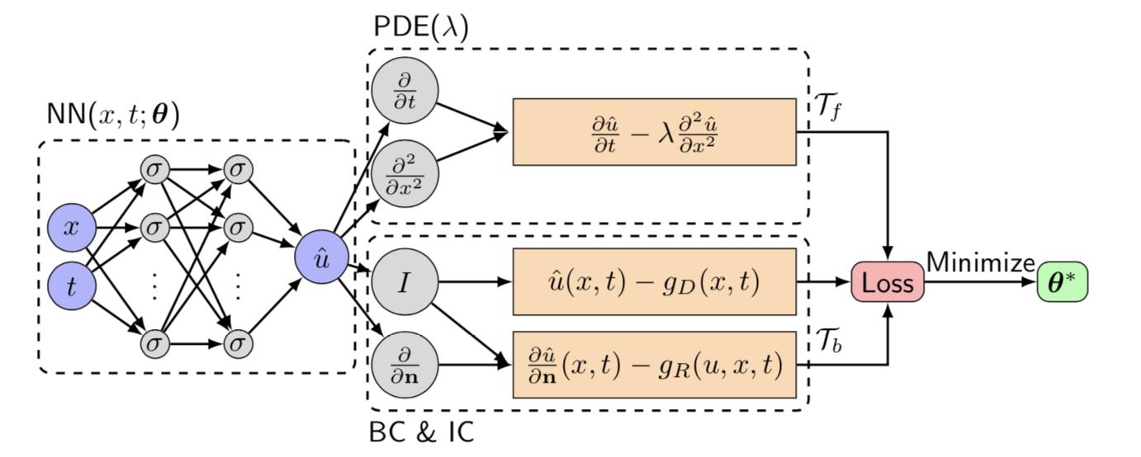
Methodologies: PINN
Physics-Informed Neural Networks
Neural Network to estimate the result function
PDE together with BC and IC as loss

Slide 5
Methodologies: PINN
Advantage:
Mesh free method
Limitation:
Need of the exact PDE function
High computation cost for training each network

Slide 6
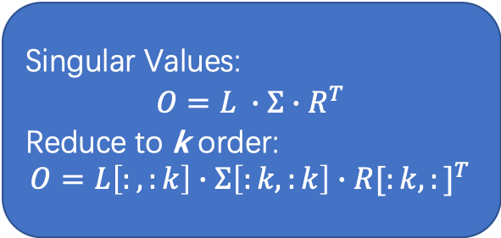
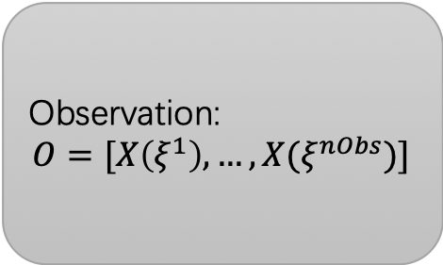
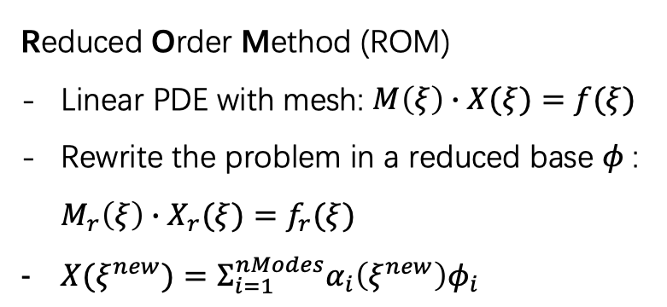
Methodologies: POD
Reduced Order Method (ROM)
Linear PDE with mesh: $M\left(ξ\right)∙X(ξ)=f(ξ)$
Rewrite the problem in a reduced base $φ$: $M_{r}\left(ξ\right)∙X_{r}(ξ)=f_{r}(ξ)$
$X(ξ^{new})=Σ_{i=1}^{nModes}α_{i}\left(ξ^{new}\right)φ_{i}$
Principal Component Analysis (PCA)
Observation:
$$O=[X\left(ξ^{1}\right),…, X(ξ^{nObs})]$$
Orthogonal Transformation
Singular Values:
$$O=L ∙Σ∙R^{T}$$
Reduce to k order:
$$O=L\left[:,:k\right]∙Σ\left[:k,:k\right]∙{R[:k,:]}^{T}$$
Computed by greedy algorithm or TensorFlow in Python
High Dimensional Model

Slide 7
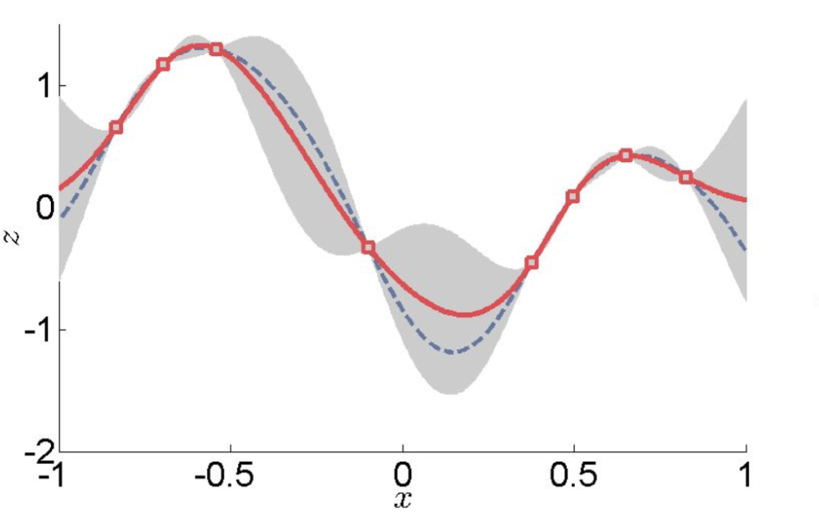
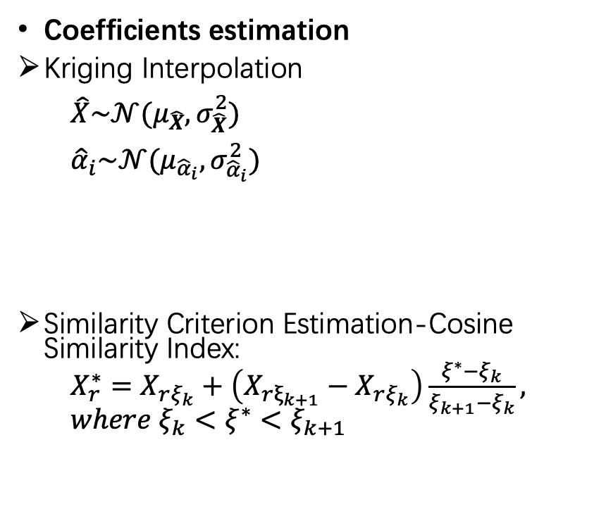
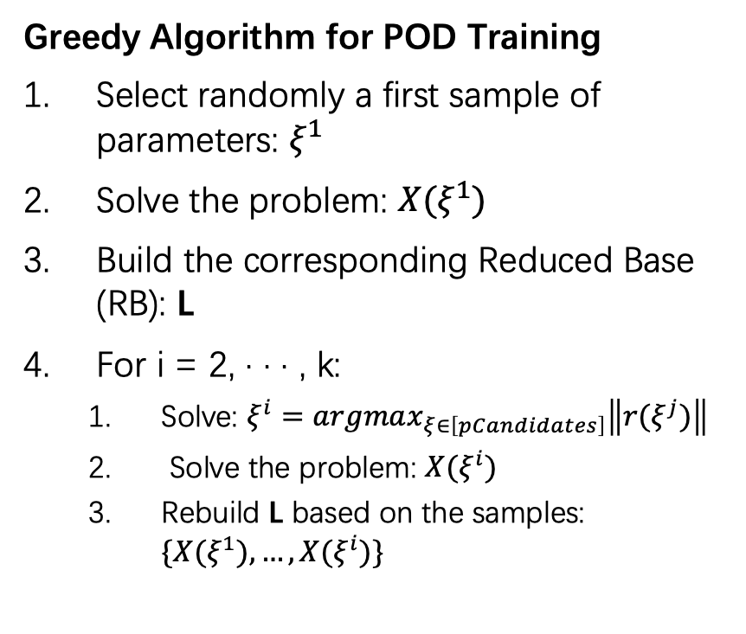
Methodologies: POD
Greedy Algorithm for POD Training
Select randomly a first sample of parameters: $ξ^{1}$
Solve the problem: ${X(ξ}^{1})$
Build the corresponding Reduced Base (RB): L
For i = 2, · · · , k:
Solve: $ξ^{i}=argmax_{ξ∈\left[pCandidates\right]}\left\|{r(ξ}^{j})\right\|$
Solve the problem: ${X(ξ}^{i})$
Rebuild L based on the samples: ${\{X(ξ}^{1}), …,{X(ξ}^{i})\}$
Coefficients estimation
Kriging Interpolation
$\hat{X}\sim 𝒩(μ_{\hat{X}},σ_{\hat{X}}^{2})$
${\hat{α}}_{i}\sim 𝒩(μ_{{\hat{α}}_{i}},σ_{{\hat{α}}_{i}}^{2})$
Similarity Criterion Estimation-Cosine Similarity Index:
$X_{r}^{∗}=X_{rξ_{k}}+\left(X_{rξ_{k+1}}−X_{rξ_{k}}\right)\frac{ξ^{∗}−ξ_{k}}{ξ_{k+1}−ξ_{k}}, where ξ_{k}<ξ^{∗}<ξ_{k+1}$

Slide 8
Existing Python Package
DeepDXE
Offering a PINN PDE solver
Requiring the geometry of pb domain, PDE, BC and IC equations
Reference:
LU LU, XUHUI MENG, ZHIPING MAO, and GEORGE EM KARNIADAKIS. DEEPXDE: A DEEP LEARNING LIBRARY FOR SOLVING DIFFERENTIAL EQUATIONS.
https://github.com/lululxvi/deepxde

Slide 9
Existing Python Package: Kriging Interpolation
SMT-KPLS
a Kriging model useing the partial least squares (PLS) method
Reference:
https://github.com/jomorlier/SMT

Slide 10
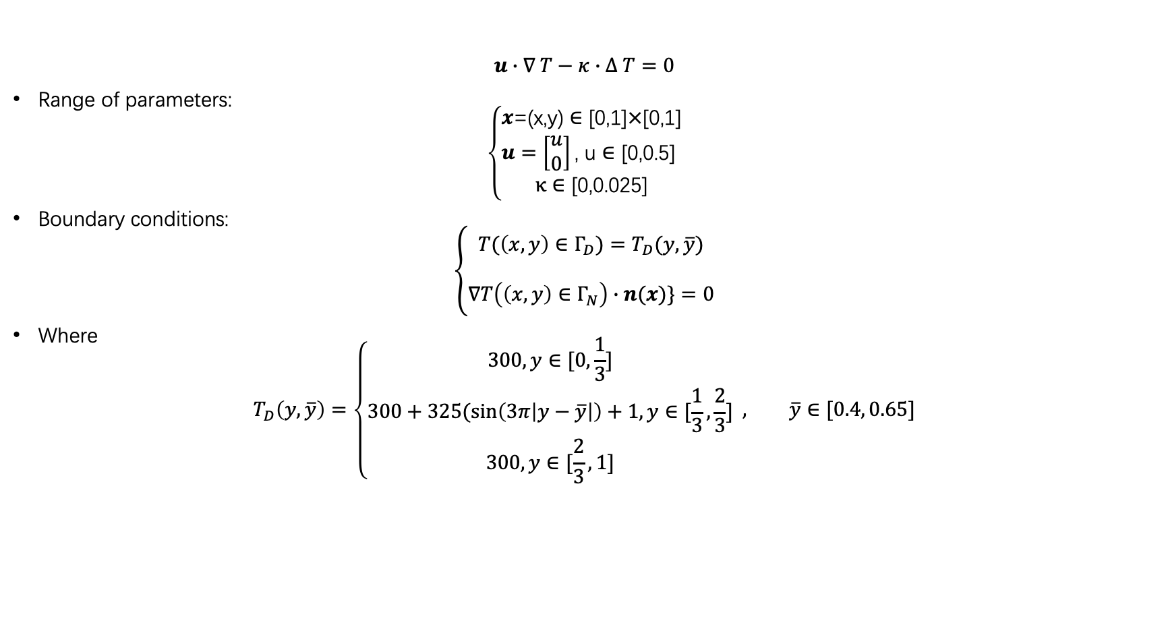
Test Case: Steady Advection-Diffusion problem
$$u∙∇ T−κ∙Δ T=0$$
Range of parameters:
$$\left\{\begin{aligned}x\text{=(}\text{x}\text{,}\text{y}\text{)}∈\text{[0,1]}×\text{[0,1]} \\ u=\left[\begin{aligned}u \\ 0\end{aligned}\right]\text{, }\text{u}∈\text{[0,0.5] } \\ κ∈\text{[0,0.025]}\end{aligned}\right.$$
Boundary conditions:
$$\left\{\begin{aligned}T(\left(x,y\right)∈Γ_{D})=T_{D}(y, \overline{y}) \\ \\ ∇T\left(\left(x,y\right)∈Γ_{N}\right)∙n(x)\}=0\end{aligned}\right.$$
Where
$$T_{D}\left(y, \overline{y}\right)=\left\{\begin{aligned}300, y∈[0,\frac{1}{3}] \\ 300+325(\sin\left(3π\left|y−\overline{y}\right|\right)+1, y∈[\frac{1}{3},\frac{2}{3}] \\ 300, y∈[\frac{2}{3}, 1]\end{aligned} , \overline{y}∈[0.4, 0.65]\right.$$

Slide 11
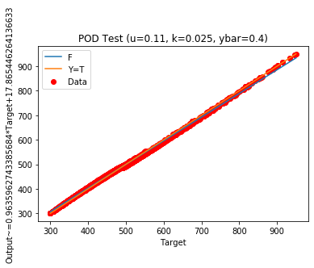
Test Case: Steady Advection-Diffusion problem (0.11, 0.025, 0.4)

Slide 12
Test Case: Steady Advection-Diffusion problem (0.5, 0.0004, 0.62)

Slide 13
Test Case: Steady Advection-Diffusion problem
 | Offline computation time (min) | Online computation time (s) | Time reduce | RMSE (0.11, 0.025, 0.4) | RMSE (0.5, 0.0004, 0.62)
Reference | / | 0.6 | / | / | /
PINN | 90 | 0.04 | 94% | 93.242366 | 85.591974
POD-Greedy Algo | 12 | 0.06 | 90% | 4.907223 | 51.347241
POD-TensorFlow & GP | 11.7 | 0.06 | 90% | 4.746199 | 53.322025
POD-TensorFlow & Similarity Criterion Estimation | 11.4 | 0.012 | 98% | 10.869671 | 181.090520
GP | 11.9 | 0.06 | 90% | 0.007552 | 26.178583
KPLS | 11.5 | 0.006 | 99% | 0.013618 | 206.149174

Slide 14
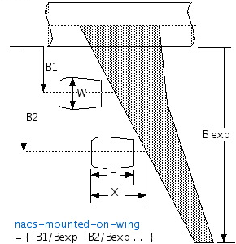
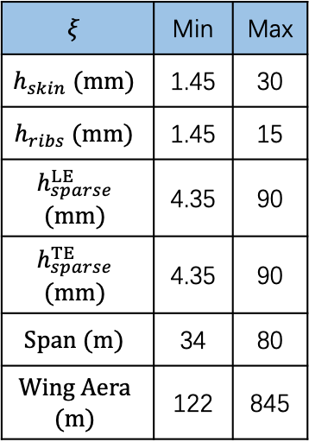
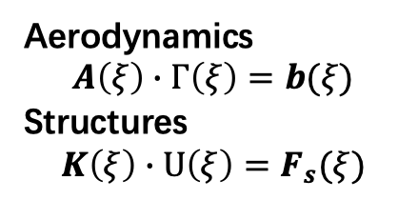
Test Case: Static Aeroelasticity
Aerodynamics → VLM Horseshoe
$$ξ$$ | Min | Max
$$h_{skin} (mm)$$ | 1.45 | 30
$$h_{ribs} (mm)$$ | 1.45 | 15
$$h_{sparse}^{LE}$$ $$(mm)$$ | 4.35 | 90
$$h_{sparse}^{TE}$$ $$(mm)$$ | 4.35 | 90
$$Span (m)$$ | 34 | 80
$$Wing Aera$$ $$(m)$$ | 122 | 845
Matrix of Transfer & Mesh deformation
Structures → FEM (DKT for plates)
Aerodynamics
$$A\left(ξ\right)∙Γ\left(ξ\right)=b(ξ)$$
Structures
$$K\left(ξ\right)∙U\left(ξ\right)=F_{s}(ξ)$$

Slide 15
Test Case: Static Aeroelasticity

Slide 16
Test Case: Static Aeroelasticity
 | Offline computation time (min) | Online computation time (s) | Time reduce | RMSE U | RMSE G | Average Von Mises Stress (Pa) | Von Mises Stress Error
Reference | / | 33.19 | / | / | / | 6328332.03 | /
POD-Greedy Algo | 450 | 0.04 | 99% | 0.029217 | 25.333554 | 2911201.64 | 0.541854
POD-TensorFlow | 75.6 | 0.04 | 99% | 0.001642 | 0.342880 | 6354422.18 | 0.063905
GP | 75.0 | 0.02 | 99% | 0.002012 | 0.455628 | 6378635.21 | 0.027692

Slide 17
Test Case: Static Aeroelasticity
PINN: difficult to rewrite the problem in a suitable form
Similarity Criterion Estimation: lack of observations
KPLS: the calculation of U not converge

Slide 18
Conclusion
The online computation time reduce is more than 90% in all the methods
The results of a linear PDE seems to follow a Gaussian distribution on the corresponding parameters domains
The final accuracy is depended of the number of observations

Slide 19
Conclusion
 | + | -
PINN |  | High training time cost
POD Greedy |  | Training time can be long
POD TF | Easy to limit the information loss caused by base reduce Fewer training time Good accuracy for all test cases
POD TF SCE | Prediction of a black box system | Great quantity of observations needed for good accuracy
GP | Prediction of a black box system Fewer training time Good accuracy for all test cases
KPLS | The least online computation time | Possible to be not converge

Slide 20
References
LU LU, XUHUI MENG, ZHIPING MAO, and GEORGE EM KARNIADAKIS. DEEPXDE: A DEEP LEARNING LIBRARY FOR SOLVING DIFFERENTIAL EQUATIONS.
https://github.com/lululxvi/deepxde
Sunil Suram. Reduced Order Modeling using TensorFlow.
Sunil Suram, Kenneth M. Bryden. Integrating a reduced-order model server into the engineering designprocess. Advances in Engineering Software 90 (2015) 169–182.
https://github.com/jomorlier/SMT
https://smt.readthedocs.io/en/latest/_src_docs/surrogate_models/kpls.html
https://github.com/mid2SUPAERO/POD-K_v2-CHANDRE

